Slide 1
Hotel Reservation Analysis Using SQL
Presented by Karishma Kolhe

Slide 2
Overview
The hotel industry uses data to make informed decisions and enhance the guest experience. This project involves working with a hotel reservation dataset to understand guest preferences, booking trends, and other operational factors. SQL will be used to query and analyze the data to answer specific questions.

Slide 3
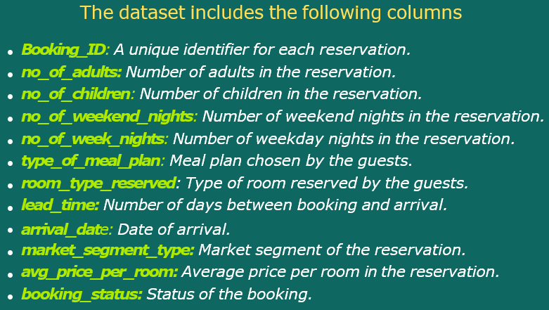
Dataset Details

Slide 4
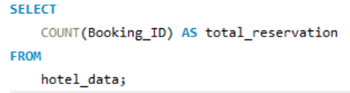

Analysis Questions and SQL Queries Q1. What is the total number of reservations in the dataset ?
QUERY:
OUTPUT:
This query counts all records in the dataset to find the total number of reservations.
There are total 700 reservations in the dataset.

Slide 5
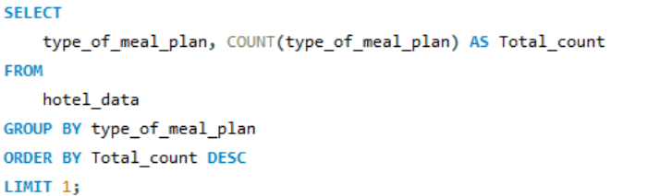
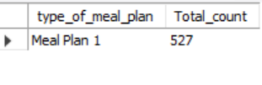
Q2. Which meal plan is most popular among guests ?
QUERY:
OUTPUT:
This query groups reservations by meal plan and orders them by count in descending order to find the most popular meal plan.
Meal Plan 1 is the most popular meal amongst the guests with total count of 527.

Slide 6
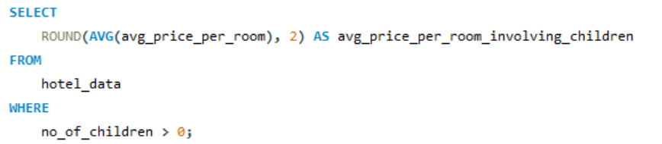

Q3. What is the average price per room for reservations involving children ?
QUERY:
OUTPUT:
This query calculates the average room price for reservations that include children.
The average price per room involving children is 144.57

Slide 7
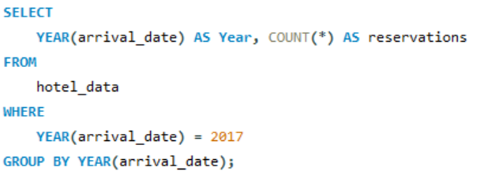

Q4. How many reservations were made for the year 20XX (replace XX with the desired year) ?
QUERY:
OUTPUT:
This query counts the number of reservations for specified years by converting the arrival date to a year format.
For year 2017, in total 123 reservations were made.

Slide 8
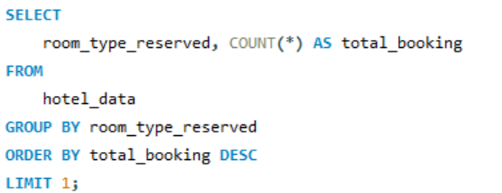

Q5. What is the most commonly booked room type ?
QUERY:
OUPUT:
This query identifies the most frequently booked room type by grouping and ordering by count.
Room Type 1 is the most commonly booked room type with total bookings of 534.

Slide 9
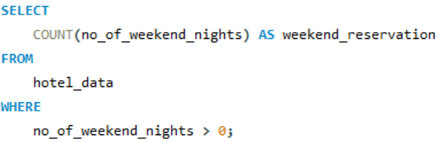

Q6. How many reservations fall on weekend (no_of_weekend_nights > 0) ?
QUERY:
OUPUT:
This query counts reservations that include weekend nights.
There are 383 weekend reservations.

Slide 10
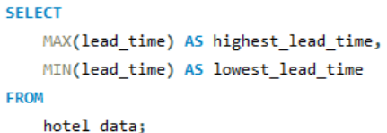

Q7. What is the highest and the lowest lead time for reservations ?
QUERY:
OUTPUT:
This query finds the maximum and minimum lead times for reservations.
The range of lead times, from 0 to 443 days, suggests diverse booking behaviors among guests. Some prefer last-minute reservations, while others plan well in advance.

Slide 11
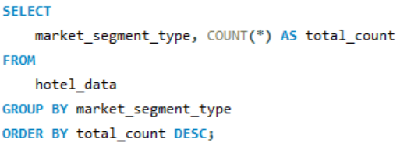
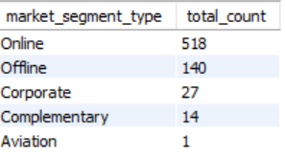
Q8. What is the most common market segment type for reservations ?
QUERY:
OUTPUT:
This query identifies the most common market segment by grouping and ordering by count.
Online is the most common market segment type for reservations.

Slide 12
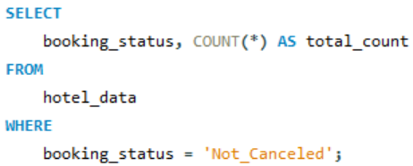

Q9. How many reservations have booking status as ‘Confirmed’ ?
QUERY:
OUPUT:
This query counts the number of reservations with a confirmed status.
There are 493 reservations which have booking status as ‘Confirmed’.

Slide 13
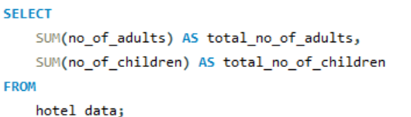

Q10. What is the total number of adults and children across all reservations ?
QUERY:
OUTPUT:
This query sums the total number of adults and children across all reservations.
The majority of reservations, totaling 1,316, involve adult guests, while a smaller number, 69, include children.

Slide 14
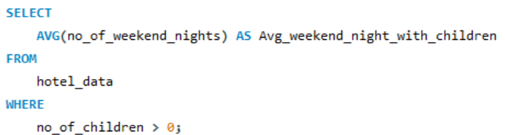

Q11. What is the average number of weekend nights for reservations involving children ?
QUERY:
OUPUT:
This query calculates the average number of weekend nights for reservations that include children.
On an average, reservations with children involve a one-night stay on weekends.

Slide 15
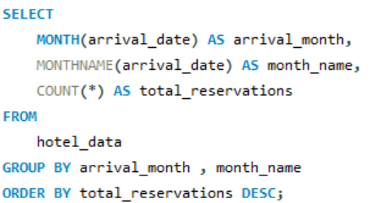
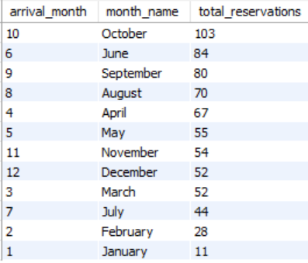
Q12. How many reservations were made in each month of the year ?
QUERY:
OUTPUT:
This query counts the number of reservations for each month by converting the arrival date to year and month format.
October stands out as the peak reservation month (103 total reservations)followed by June and September . In contrast, January records the lowest number of reservations (11 total reservations), indicating a quieter period.

Slide 16
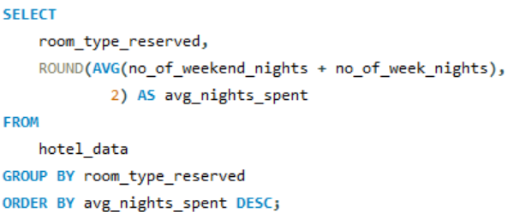
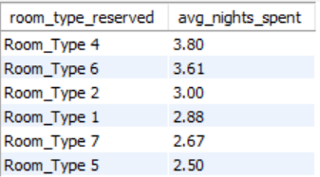
Q13. What is the average number of nights (both weekend and weekday) spent by guests for each room ?
QUERY:
OUTPUT:
This query calculates the average number of nights spent by guests for each room type.
Guests staying in Room Type 4 tend to spend the most nights on average (3.80), while those in Room Type 5 have the lowest average stay duration (2.50).

Slide 17
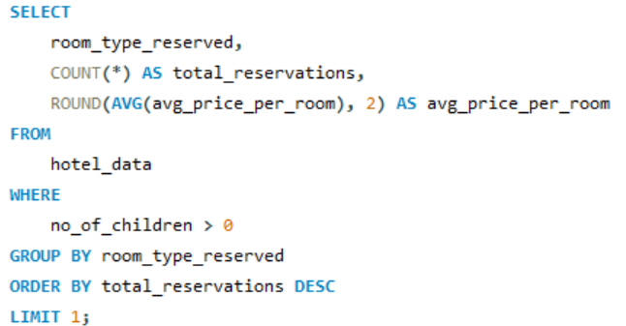

Q14. For reservations involving children, what is the most common room type, and what is the average price for that room type ?
QUERY:
OUTPUT:
This query identifies the most common room type for reservations with children and calculates the average price for that room type.
For reservations involving children, Room Type 1 is the preferred choice, with an average room price of 123.12.

Slide 18
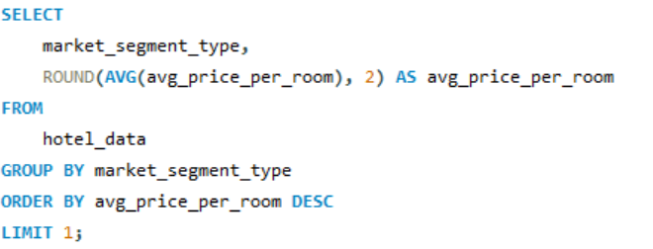

Q15. Find the market segment type that generates the highest average price per room.
QUERY:
OUTPUT:
This query identifies the market segment that generates the highest average price per room.
Online bookings generate the highest average room price, reaching 112.46

Slide 19
Insights
The most popular meal plan is identified, showing guest preferences.
Average price per room for reservations with children helps understand family booking behavior.
The most commonly booked room type aids in inventory management.
Analyzing weekend reservations provides insights into peak times.
Understanding lead times helps in anticipating booking behavior.
Market segment analysis reveals which segments are most lucrative.

Slide 20
Recommendations
Implement targeted promotions for Room Type 1 to capitalize on its popularity.
Tailor marketing strategies to attract online bookings, the most prevalent segment.
Explore partnerships or promotions to boost reservations during quieter months like January.
Enhance confirmation and booking processes to maintain the high success rate of reservations.
Focus on enhancing services and promotions during weekdays to meet the strong demand for reservations on weekday nights (656), creating an opportunity to attract a larger number of guests.
Continue monitoring and adapting strategies based on changing guest preferences and market trends.

Slide 21
Thank You !!
For watching this presentation

